Slide 1
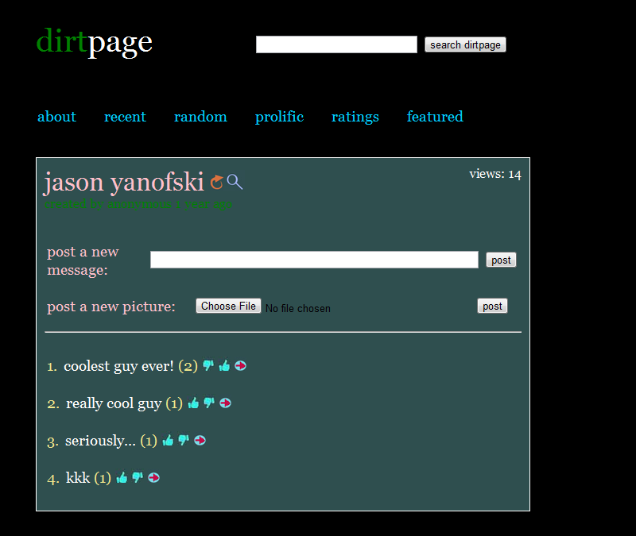
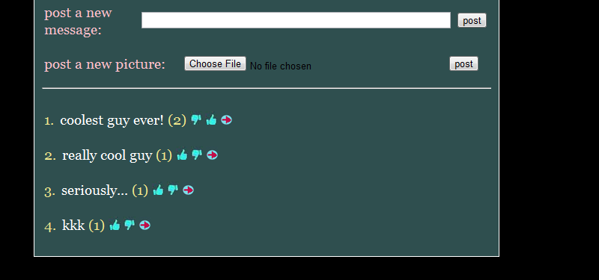
Tags:
#doctor (6) #ugly (13) #handsome (2)
#germany (1)

